Slide 1
Introduction to
SQL

Slide 2
What is SQL?
◆ Structured Query Language
◆ SQL is Structured Query Language, which is a computer language for storing, manipulating and retrieving data stored in relational database.
◆ SQL is the standard language for Relation Database System. All relational database management systems like “MySQL, MS Access, Oracle, Sybase, Informix, postgres and SQL Server” use SQL as standard database language.

Slide 3
SQL Commands
◆ DDL - Data Definition Language
◆ DML - Data Manipulation Language
◆ DCL - Data Control Language
◆ DQL - Data Query Language

Slide 4
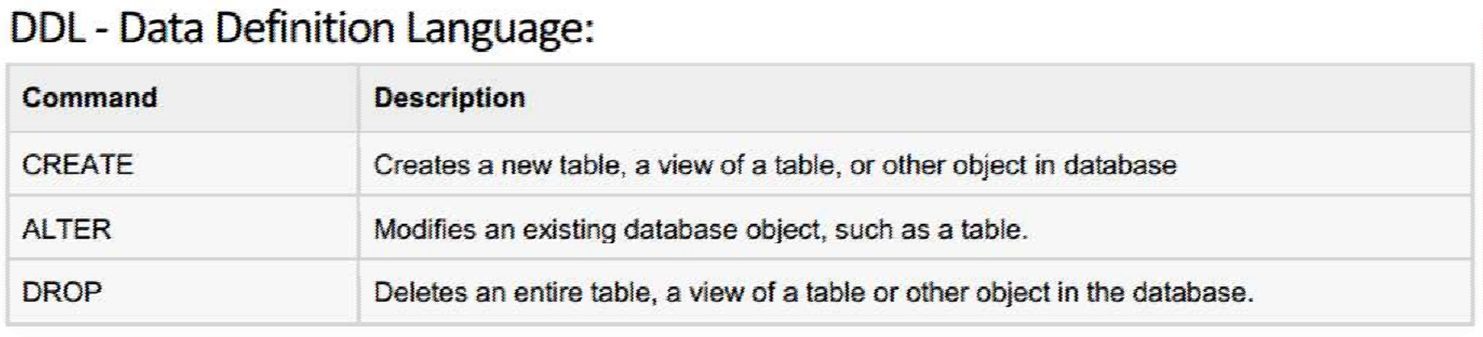

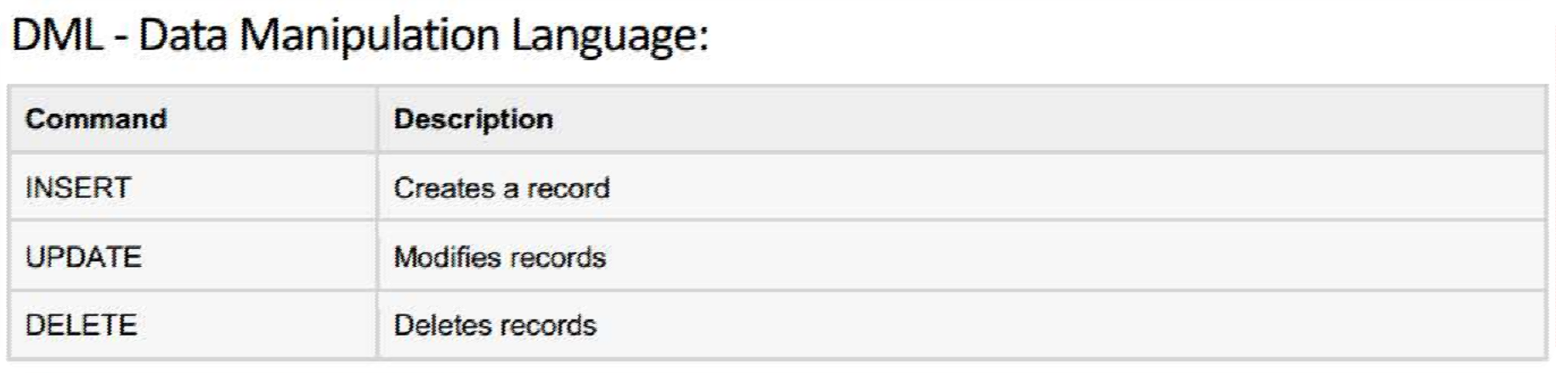
SQL Commands

Slide 5
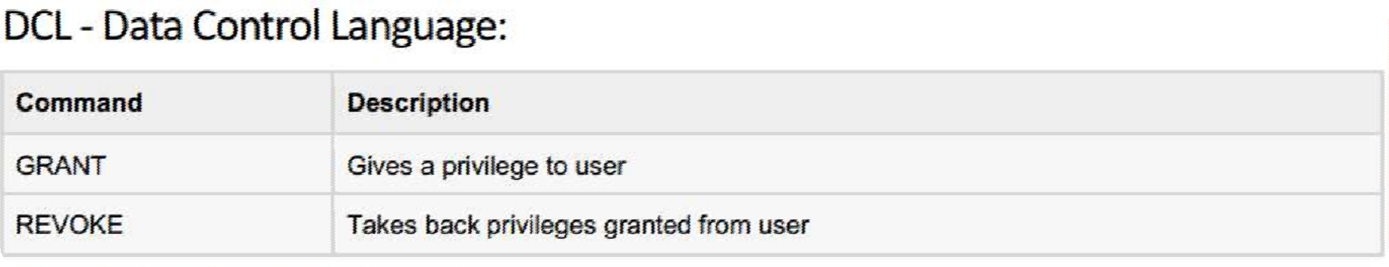

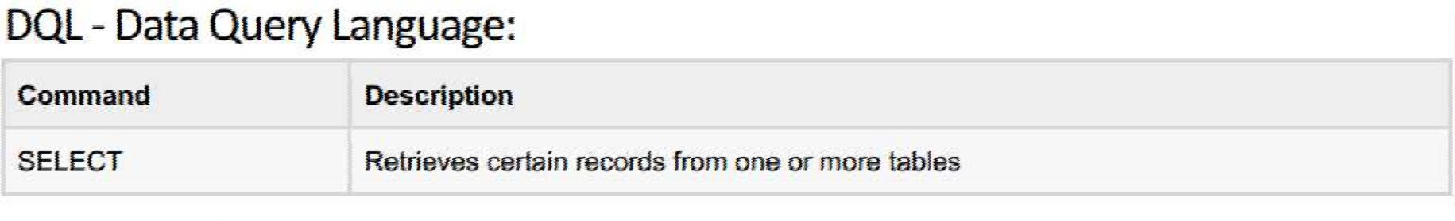

SQL Commands

Slide 6
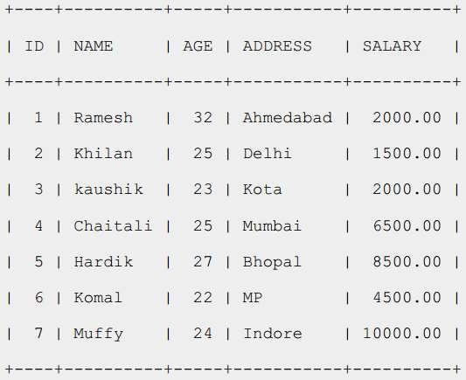
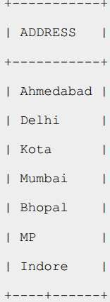
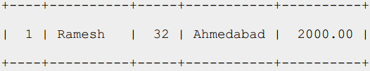
SQL RDBMS Concepts
◆ TABLE
◆ RECORD
◆ COLUMN
◆ CELL
◆ NULL?

Slide 7
SQL RDBMS Concepts
◆ SQL Constraints: (applied on columns)
◆ NOT NULL Constraint
◆ UNIQUE Constraint
◆ PRIMARY Key
◆ FOREIGN Key
◆ CHECK Constraint
◆ Data Integrity:
◆ Entity Integrity: There are no duplicate rows in a table
◆ Domain Integrity: Enforces valid entries for a given column by
restricting the type
◆ Referential Integrity: Rows cannot be deleted which are used by
other records
◆ User-Defined Integrity: Enforces some specific business rules

Slide 8
SQL RDBMS Concepts
◆ Data Types:
◆ Character datatypes:
◆ CHAR
◆ NCHAR
◆ NVARCHAR2
◆ VARCHAR2
◆ Numeric datatypes:
◆ NUMBER
◆ BINARY_FLOAT
◆ BINARY_DOUBLE
◆ Date time datatype:
◆ DATE

Slide 9
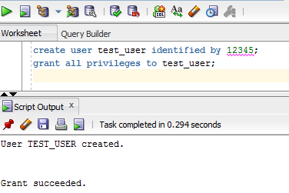
DCL: CREATE USER
◆ 1) Define User with Username/Password
◆ 2) Grants Sufficient Privileges.
◆ Using SQL Developer (UI, Command)
◆ Using SQL *PLUS (Command)

Slide 10
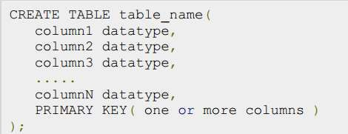
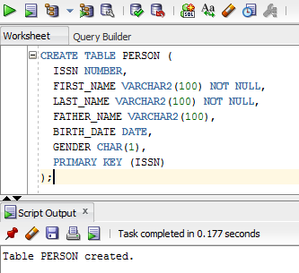
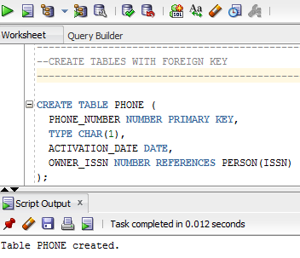
SQL : DDL
◆ Create Table:
◆ COLUMNS
◆ CONSTRAINTS

Slide 11
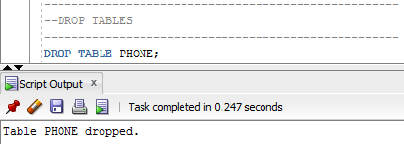
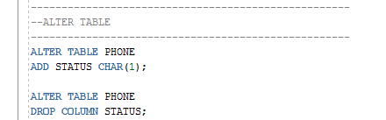
SQL: DDL
◆ DROP TABLE:
◆ ALTER TABLE
◆ OTHER DDL COMMANDS!!!!

Slide 12
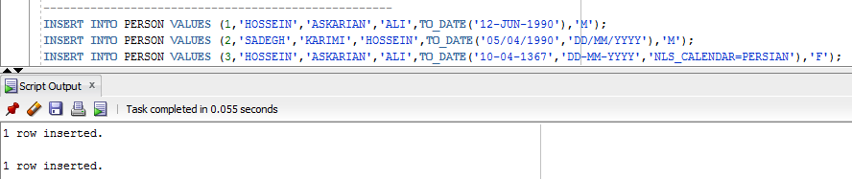
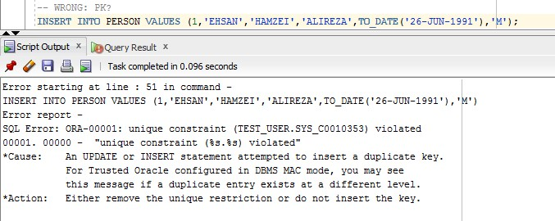
SQL: DML: INSERT
◆ INSERT INTO:
◆ NUMBER, CHAR/VARCHAR2, DATE?

Slide 13

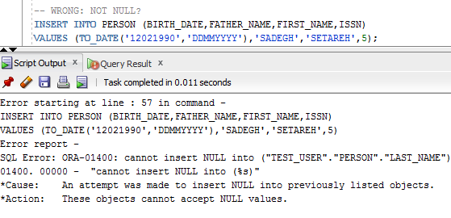
SQL: DML: INSERT
◆ INSERT INTO:
◆ SPECIFIC COLUMNS

Slide 14
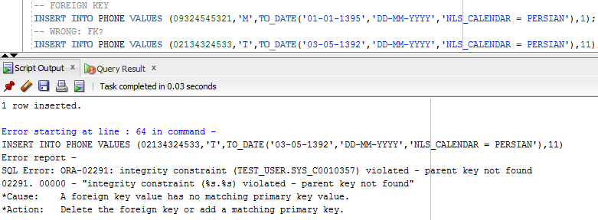
SQL: DML: INSERT
◆ INSERT INTO:
◆ FOREIGN KEY
◆ ALL DML COMMANDS NEED COMMIT

Slide 15
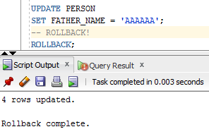
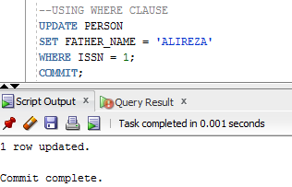
SQL: DML: UPDATE
◆ UPDATE
◆ WHERE CLAUSE

Slide 16
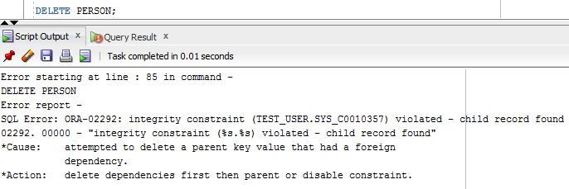
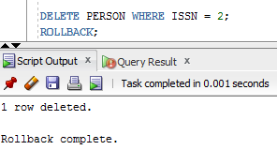
SQL: DML: DELETE
◆ DELETE (DELETE VS DROP????)

Slide 17
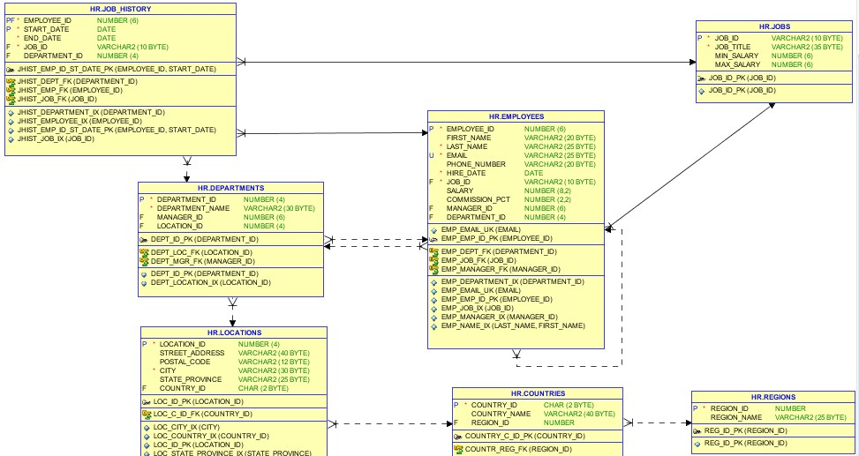
HR-Schema

Slide 18
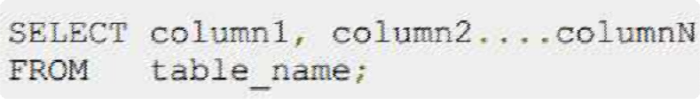

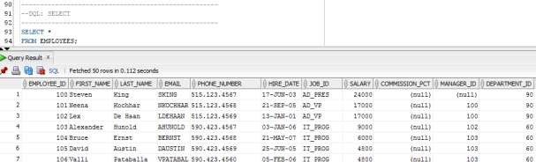
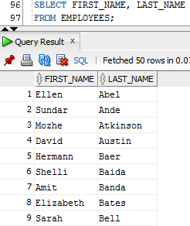
SQL: DQL: SELECT
◆ SELECT
◆ *
◆ SPECIFIC COLUMNS

Slide 19

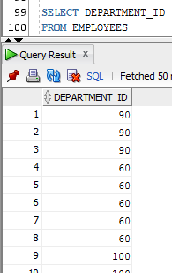
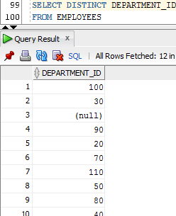
SQL: DQL: SELECT
◆ DISTINCT CLUASE

Slide 20
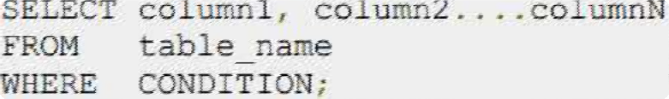

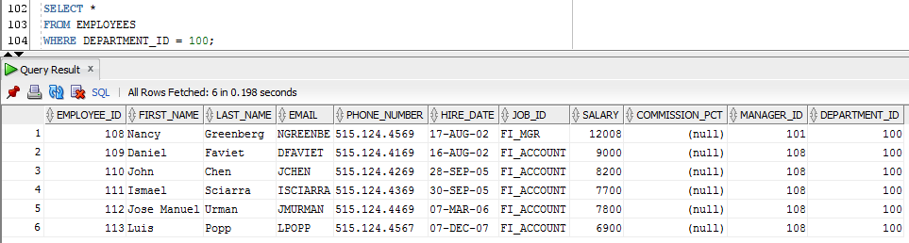
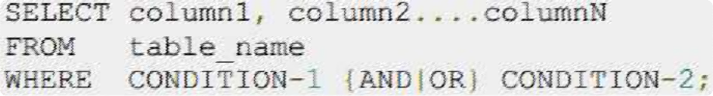

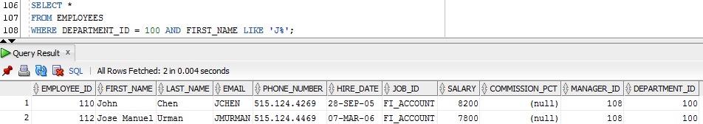
SQL: DQL: SELECT
◆ WHERE CLUASE

Slide 21
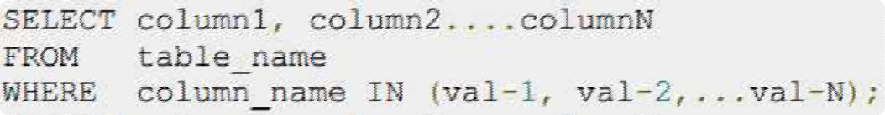

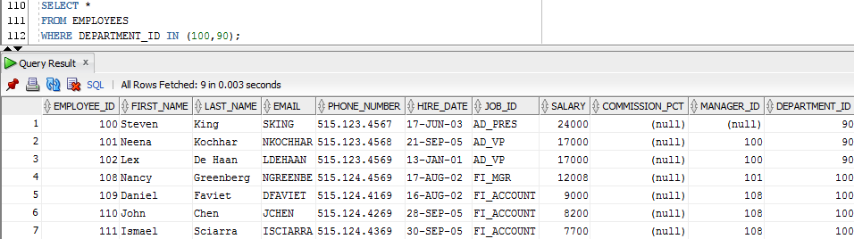
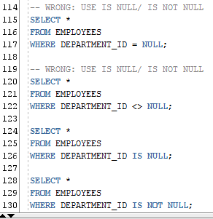
SQL: DQL: SELECT
◆ IN CLUASE
◆ NOT IN
◆ NULL IN WHERE?
◆ IS NULL
◆ IS NOT NULL

Slide 22
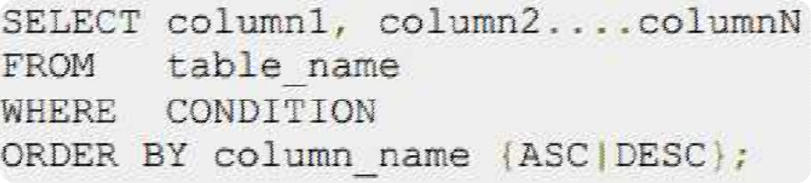

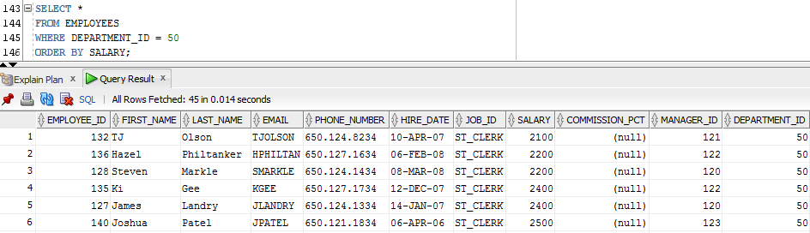
SQL: DQL: SELECT
◆ ORDER BY

Slide 23
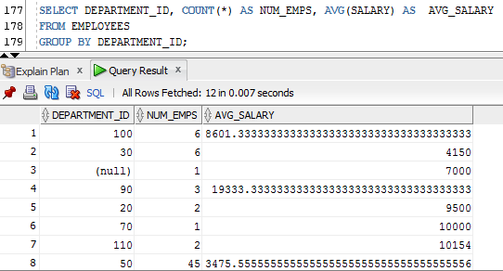
SQL: DQL: SELECT
◆ GROUP BY
◆ AGGREGATE FUCTION
◆ MAX,MIN
◆ AVG
◆ COUNT
◆ SUM
◆ …
◆ HAVING CLAUSE

Slide 24
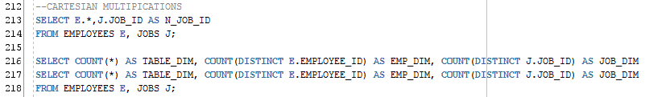
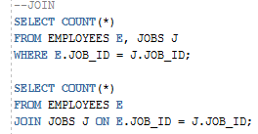
SQL: DQL: SELECT
◆ SELECT FROM MULTIPLE TABLES
◆ CARTESIAN MULTIPICATION
◆ JOIN

